Slide 1
Analysis of Algorithms
Review

Slide 2
Asymptotic notations
A way to describe behavior of functions in the limit
  Abstracts away low-order terms and constant factors
  How we indicate running times of algorithms
  Describe the running time of an algorithm as n goes to ∝
O notation: asymptotic “less than”: f(n) “≤” g(n)
Ω notation: asymptotic “greater than”: f(n) “≥” g(n)
Θ notation: asymptotic “equality”: f(n) “=” g(n)

Slide 3
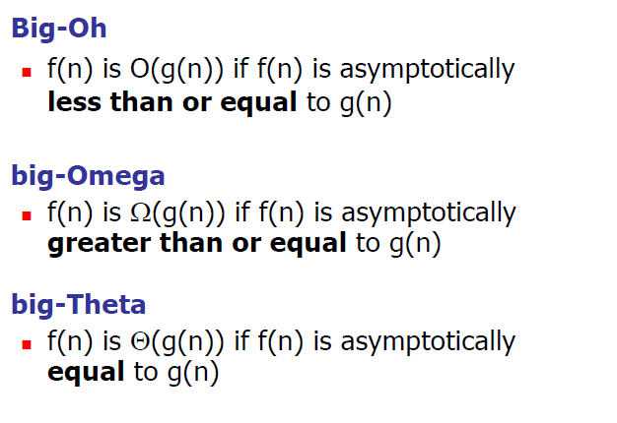
Intuition for Asymptotic Analysis

Slide 4
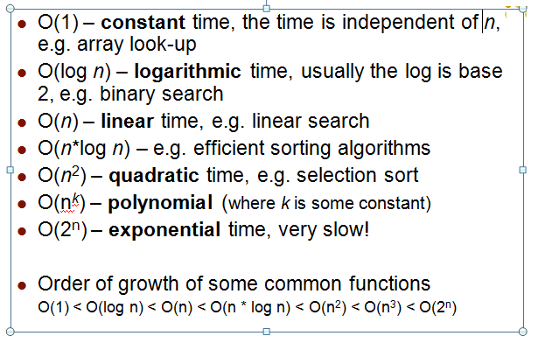
Asymptotic Efficiency Classes

Slide 5
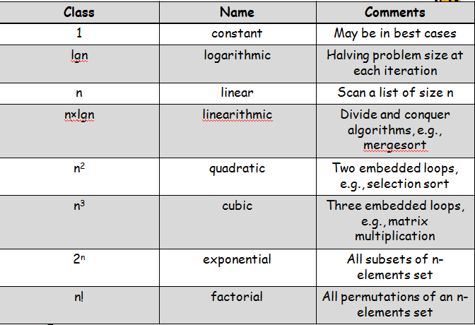
Basic Efficiency Classes

Slide 6
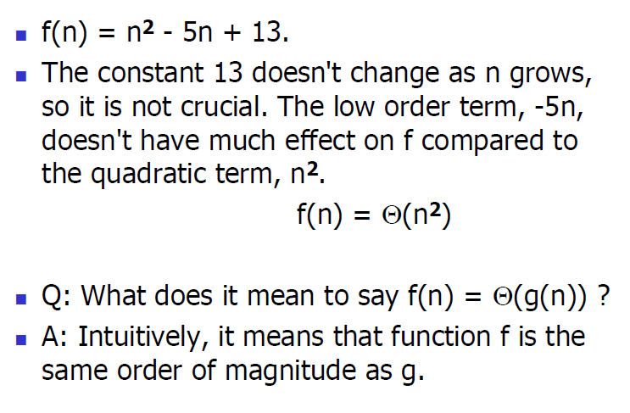
Review

Slide 7
Problems
    N² = O(N²) true
    2N = O(N²) true
    N = O(N²) true
    N² = O(N) false
    2N = O(N) true
    N = O(N) true
    N² = Θ (N²) true
    2N = Θ (N²) false
    N = Θ (N²) false
    N² = Θ (N) false
    2N = Θ (N) true
    N = Θ (N) true

Slide 8
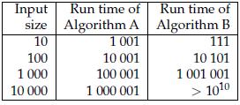
Example
Suppose you have analyzed two algorithms and expressed their run times in terms of the size of the input:
Algorithm A takes 100n + 1 steps to solve a problem with size n;
Algorithm B takes n² + n + 1 steps.
The following table shows the run time of these algorithms for different problem sizes:

Slide 9
Example Contd.,
At n = 10, Algorithm A looks pretty bad; it takes almost 10 times longer than Algorithm B. But for n = 100 they are about the same, and for larger values A is much better.
The fundamental reason is that for large values of n, any function that contains an n² term will grow faster than a function whose leading term is n. The leading term is the term with the highest exponent.
For Algorithm A, the leading term has a large coefficient, 100, which is why B does better than A for small n.

Slide 10

Exercise
Order the following 6 functions in increasing order of their growth rates:
  nlog n, log²n, n², 2^{n} , , n.
  log²n
  n
  nlogn
  n²
  2^{n}

Slide 11
Running Time Analysis
Algorithm Loop1(n)
  p=1
  for i = 1 to 2n
    p = p*i
Algorithm Loop2(n)
p=1
for i = 1 to n²
p = p*i
O(n)
O(n²)

Slide 12
Running Time Analysis
Algorithm Loop3(n)
s=0
for i = 1 to n
for j = 1 to i
s = s + I
O(n²)

Slide 13
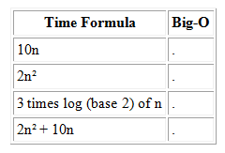
Questions for review
Convert each time formula to the best possible big-O notation. Do not include any spurious constants in your big-O answer.

Slide 14
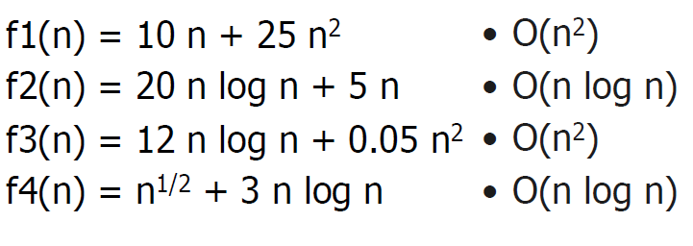
Review

Slide 15
Review

Slide 16
Review Questions
What does a run-time analysis usually count?
  A. The number of arithmetic and other operations required for the program to run
  B. The number of megabytes required for the program to run
  C. The number of seconds required for the program to run
  D. The number of seconds plus the number of megabytes
  E. The number of seconds times the number of megabytes

Slide 17
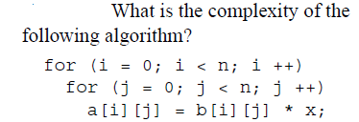
Review

Slide 18
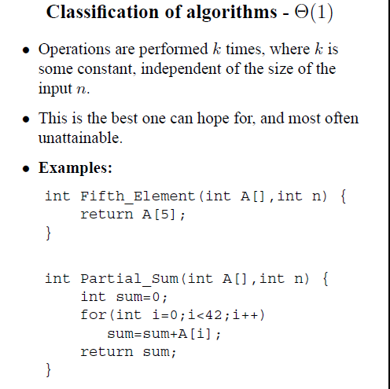
Constant Time

Slide 19
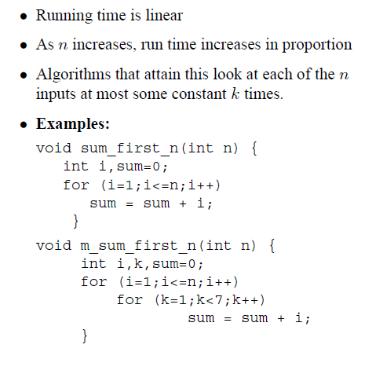
Classification of algorithms- Linear

Slide 20
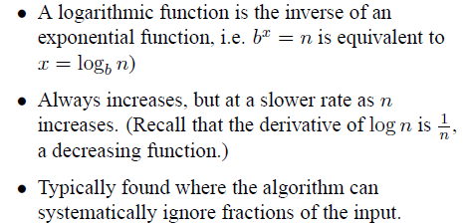
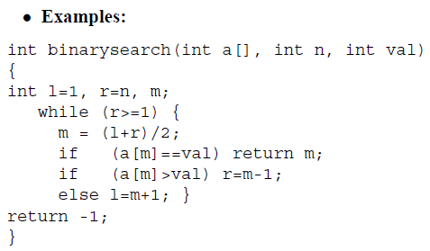
Classification of algorithms- Logarithmic

Slide 21

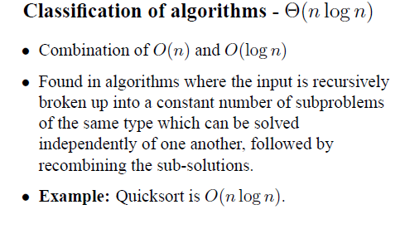
N log n

Slide 22
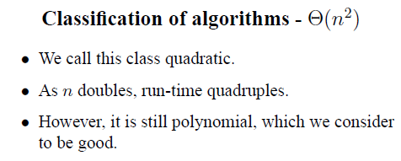
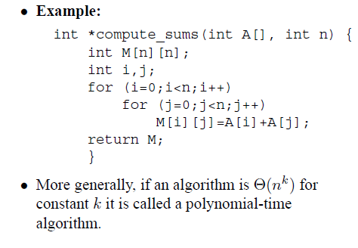
Quadratic

Slide 23
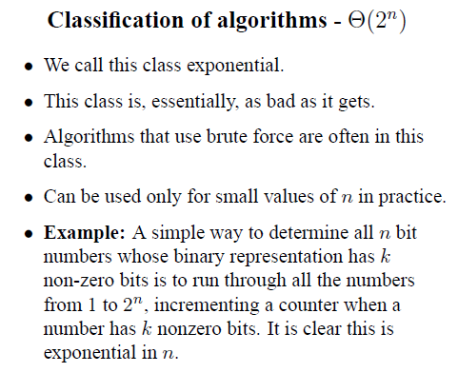
Exponential

Slide 24
Review Questions
Which of these is the correct big-O expression for 1+2+3+...+n?
  A. O(log n)
  B. O(n)
  C. O(n log n)
  D. O(n²)

Slide 25
Review Questions
Which of the following formulas in big-O notation best represent the expression n²+35n+6?
  A. O(n³)
  B. O(n²)
  C. O(n)
  D. O(42)

Slide 26
Review Questions
Express the formula (n - 2)*(n - 4) using big-O notation:
  A. O(1)
  B. O(8)
  C. O(log n)
  D. O(n)
  E. None of the above

